Slide 1
Introduction to MySQL Views
Let’s see the following tables employees , departments and locations.
This query returns data from all tables employees, departments and locations using the inner join.
SELECT first_name,last_name,city,department_name FROM employees e INNER JOIN departments d on(e.department_id=d.department_id) INNER JOIN locations l on (l.location_id=d.location_id);
Next time, if you want to get the same information ,A better way to do this is to save the query in the database server and assign a name to it. This named query is called a database view, or simply, view.

Slide 2
Eg:
CREATE OR REPLACE VIEW EMPLOYEE_VU
as
SELECT first_name ,last_name,city ,department_name , postal_code
FROM employees E INNER JOIN departments d on(e.department_id=d.department_id) INNER JOIN locations l on (l.location_id=d.location_id);
SELECT * FROM EMPLOYEE_VU;
Note that a view does not physically store the data.
When you issue the SELECT statement against the view, MySQL executes the underlying query specified in the view’s definition and returns the result set.
For this reason, sometimes, a view is referred to as a virtual table.

Slide 3
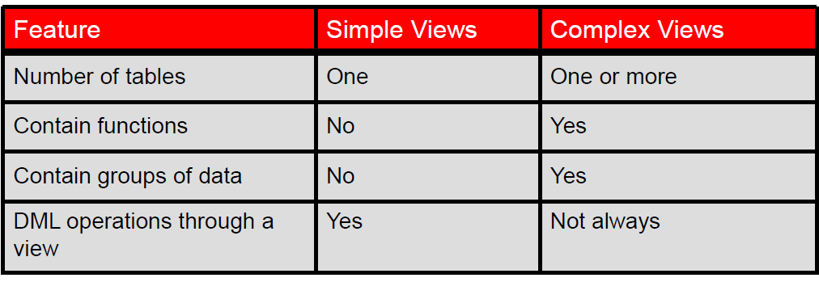
Simple Views and Complex Views
With the REPLACE option, a view can be created even if one exists with this name already , thus replacing the old version of the view.
You can remove a view without losing data because a view is based on underlying tables in the database.
You use the DROP VIEW statement to remove a view.
Eg:
DROP VIEW EMPLOYEE_VU

Slide 4

Introduction to MySQL INDEXS
Improves the performance of data retrieval queries by using a pointer and improves the performance of queries.
Is used and maintained automatically by the MySQL server.
SHOW INDEXES from TABLE;
There are a few main benefits of using indexes in MySQL and these are as follows:
Indexes allow to quickly find rows matching a WHERE clause;
Indexes might help queries avoid searching through certain rows thus reducing the amount of data the server needs to examine - if there is a choice between multiple indexes, MySQL usually uses the most selective index, that is such an index that finds the smallest amount of rows;
Indexes might be used in order to retrieve rows from other tables in JOIN operations;

Slide 5
create index idd1 on employees(employee_id);
DROP INDEX idd1 on employees;
ALTER TABLE emp DROP INDEX iddh;

Slide 6
Introduction to MySQL SEQUENCE
In MySQL, a sequence is a list of integers generated in the ascending order i.e., 1,2,3… Many applications need sequences to generate unique numbers mainly for identification
Eg:create table employees (id int auto_increment primary key ,name char(20));
The following rules are applied when you use the AUTO_INCREMENT attribute:
Each table has only one AUTO_INCREMENT column whose data type is typically the integer.
The AUTO_INCREMENT column must be indexed, which means it can be either PRIMARY KEY or UNIQUE index.
mysql> create table employees (id int auto_increment ,name char(20));
ERROR 1075 (42000): Incorrect table definition; there can be only one auto column and it must be defined as a key

Slide 7
A column can be defined to have AUTO INCREMENT property during table creation or later using the ALTER TABLE method. The default value of AUTO INCREMENT is 1 and it moves by 1 after every successful insertion.
Please note that any deletions that would happen in the table would not impact the AUTO INCREMENT value and the new records would still keep getting incremented values.
The columns having an AUTO INCREMENT option are usually used to indicate PRIMARY KEYS where uniqueness is desired.
Only numeric fields like INT can be assigned the AUTO_INCREMENT option.
Assigning AUTO_INCREMENT to an incompatible data type would return in an error being thrown during query execution.
MySQL AUTO INCREMENT can be reset using the ALTER TABLE command. This is useful when you want to change the current index of the AUTO_INCREMENT column.
Eg: ALTER TABLE employees AUTO_INCREMENT=5000
The above query would reset the AUTO_INCREMENT counter to 5000.

Slide 8
Introduction to MySQL TRIGGERS
A trigger is a named database program that is associated with a table,
and that activates when a particular event occurs for the table.
Some uses for triggers are to perform checks of values to be inserted into a table or to perform calculations on values involved in an update.
In MySQL, a trigger is a stored program invoked automatically
in response to an event such as insert, update, or delete that occurs in the associated table.
Eg:
create table medicine(mid int,
medname char(30),price decimal(11,2),
quantity int );
desc medicine;
create table neworder(
mid int,odate date,newquantity int
);

Slide 9
insert into medicine values (1,'crosin',250,30);
insert into medicine values (2,'colpol',380,45);
select * from medicine;
delimiter $$
create trigger neworderformedicine
after update on medicine
for each row
begin
if new.quantity<20 then
insert into neworder values (new.mid,current_date(),200) ;
end if;
end;
$$
select * from neworder $$
update medicine set quantity=15 where mid=2;
select * from neworder $$

Slide 10
Introduction to MySQL PROCEDURES
A procedure is a subprogram in a regular scripting language, stored in a database.
In the case of MySQL, procedures are written in MySQL and stored in the MySQL database/server.
A MySQL procedure has a name, a parameter list, and SQL statement(s).
DELIMITTER //
create procedure addemployees ( in spid int, in spname varchar(20) )
begin
insert into emp_data values (spid,spname);
end//
create table emp_data(id int,name varchar(20))//
call addemployees(1,'smith')//
select * from emp_data;

Slide 11
MySQL Error Handling in Stored Procedures:
use MySQL handler to handle errors encountered in stored procedures.
When an error occurs inside a stored procedure, it is important to handle it appropriately,
such as continuing or exiting the current code block’s execution,
and issuing a meaningful error message.
DECLARE action HANDLER FOR condition_value statement;
CREATE PROCEDURE display_tab()
begin
declare exit handler for 1146
begin
select 'no table' as message;
end;
select * from student_sub_info;
end;
$$
show tables$$
DROP PROCEDURE display_tab$$
CALL display_tab()$$

